Slide 1


Session no.15
Subject: Engineering Chemistry
Course Code: ETCH104
Program: B.Tech. CSE (Full Stack/IBM/DS) SEM-I
Faculty Name: Dr. Divyanshi Mangla
(Assistant Professor)
School of Basic and Applied Sciences

Slide 2

Table of Contents
Pre-requisite
Electrochemical Cells
Quiz
Support Material

Slide 3
Pre-requisite
Basic knowledge of Class 12th Chemistry
Electrode potential
Redox reactions

Slide 4
Course Outcomes
CO1 | Understand the methods for water hardness and the basics of boiler water treatment and analyze fuel calorific values and battery. | BTL2
CO2 | Explain the characteristics and working principles of different battery types and types of fuels. | BTL2
CO3 | Determine the differences between batteries and fuel cells and classify fuel cell types based on their components. | BTL4
CO4 | Identify between hard and soft water, solve the related numerical problems on water purification and emf and its significance in industry and daily life. | BTL3

Slide 5
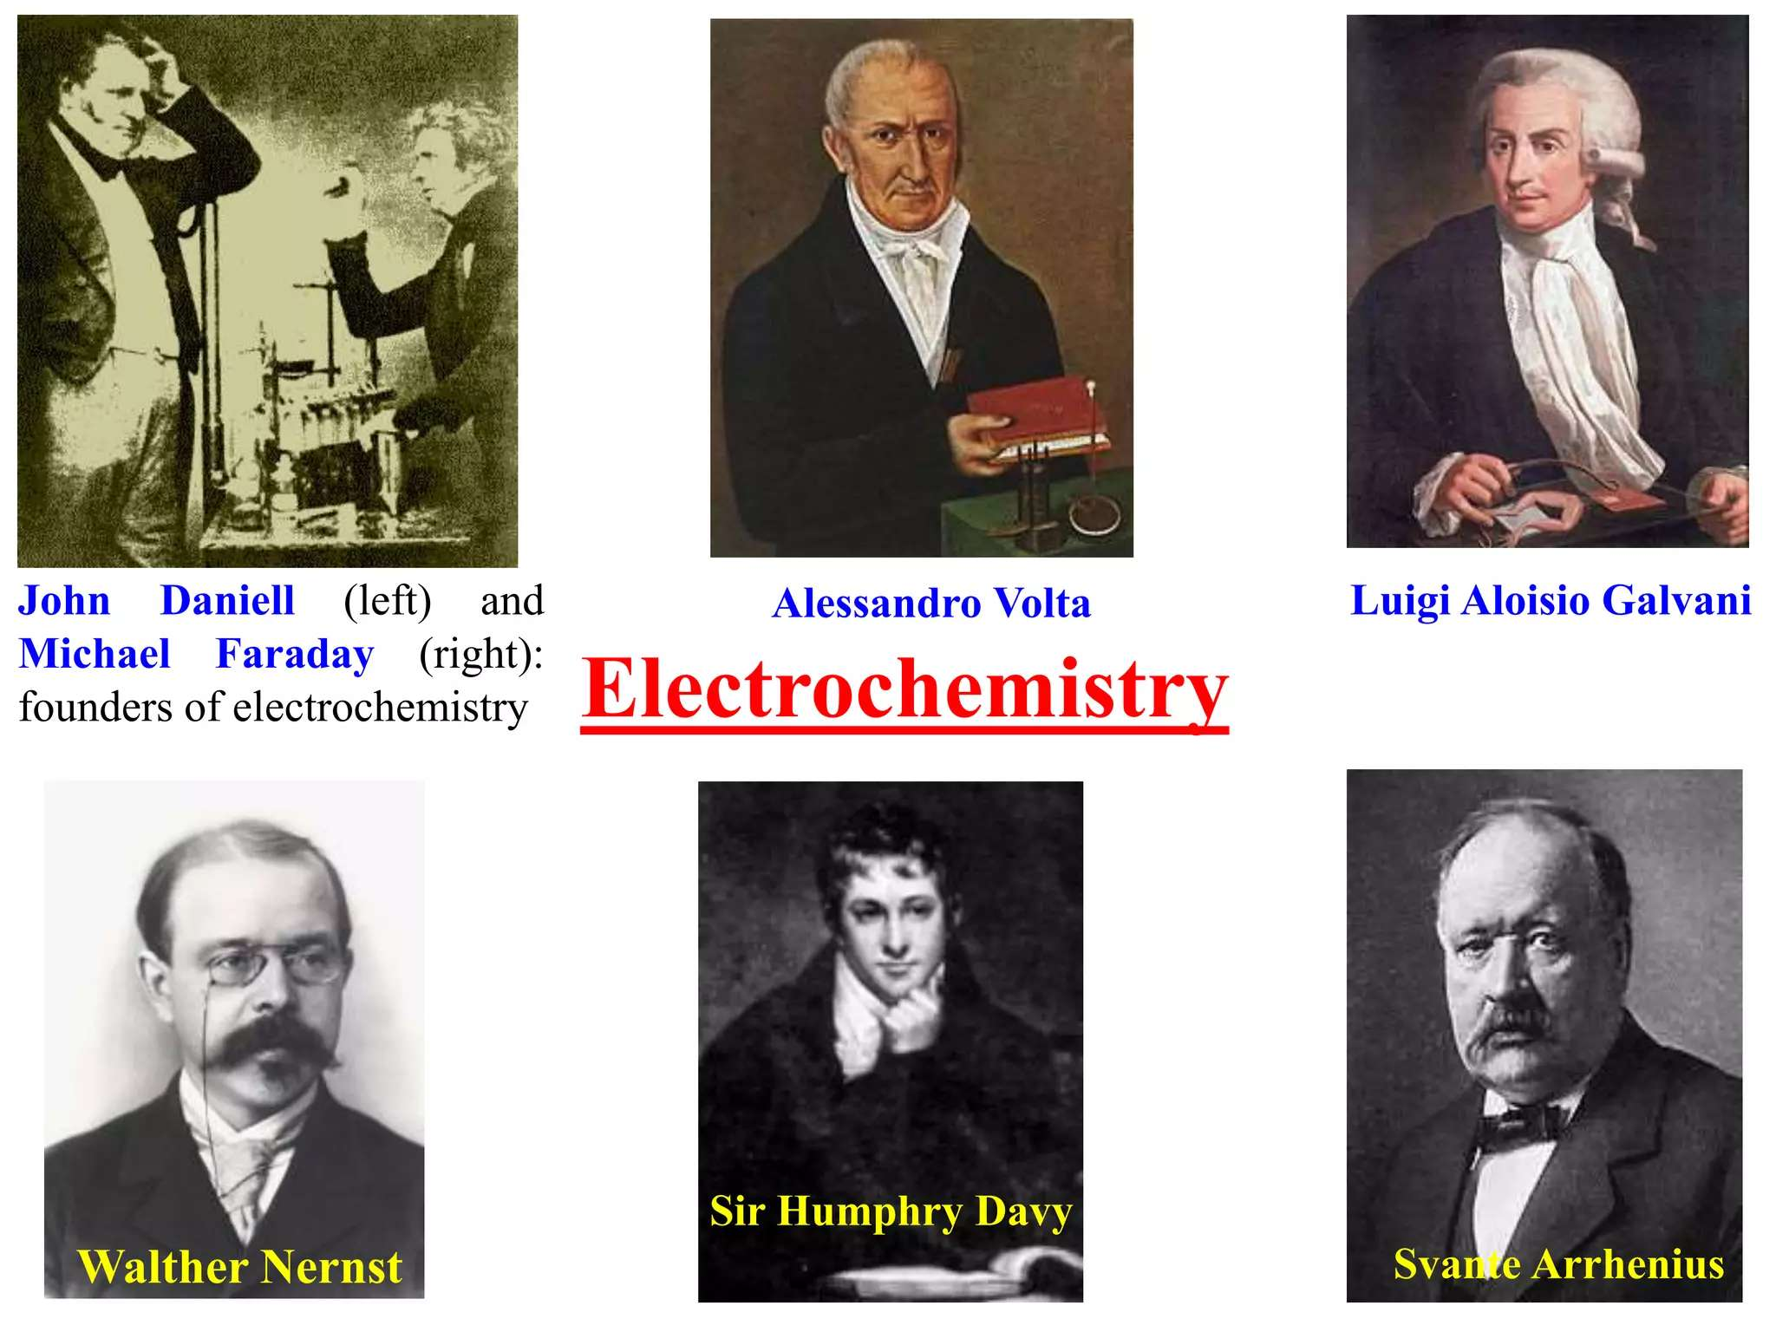


Slide 6
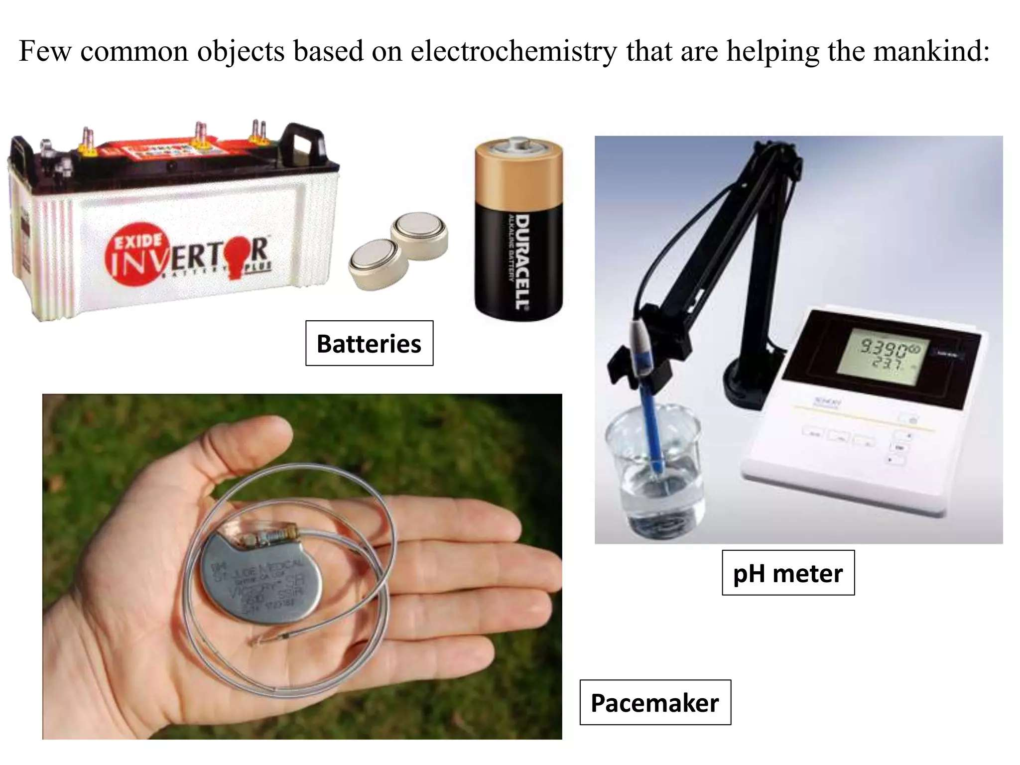

Slide 7
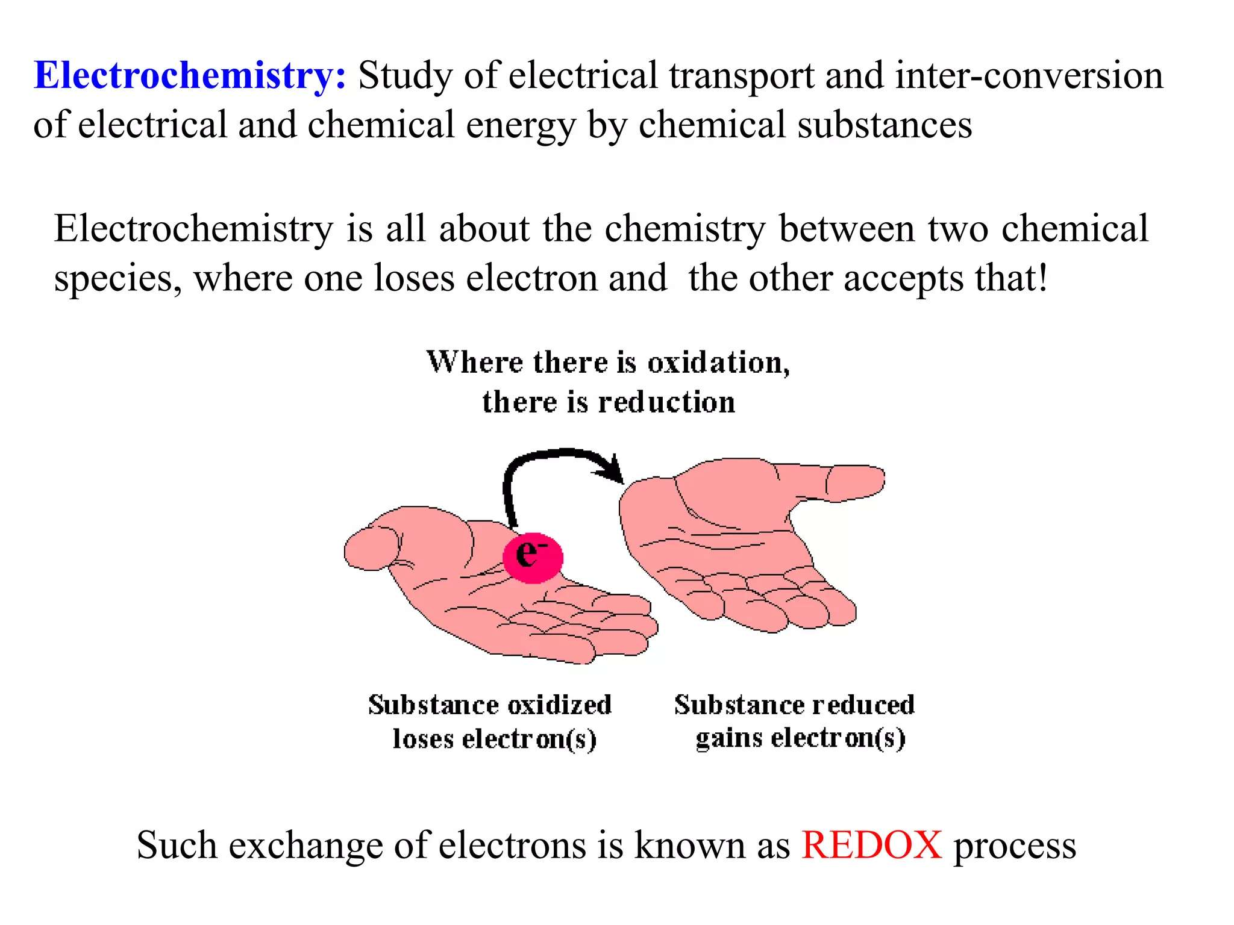

Slide 8
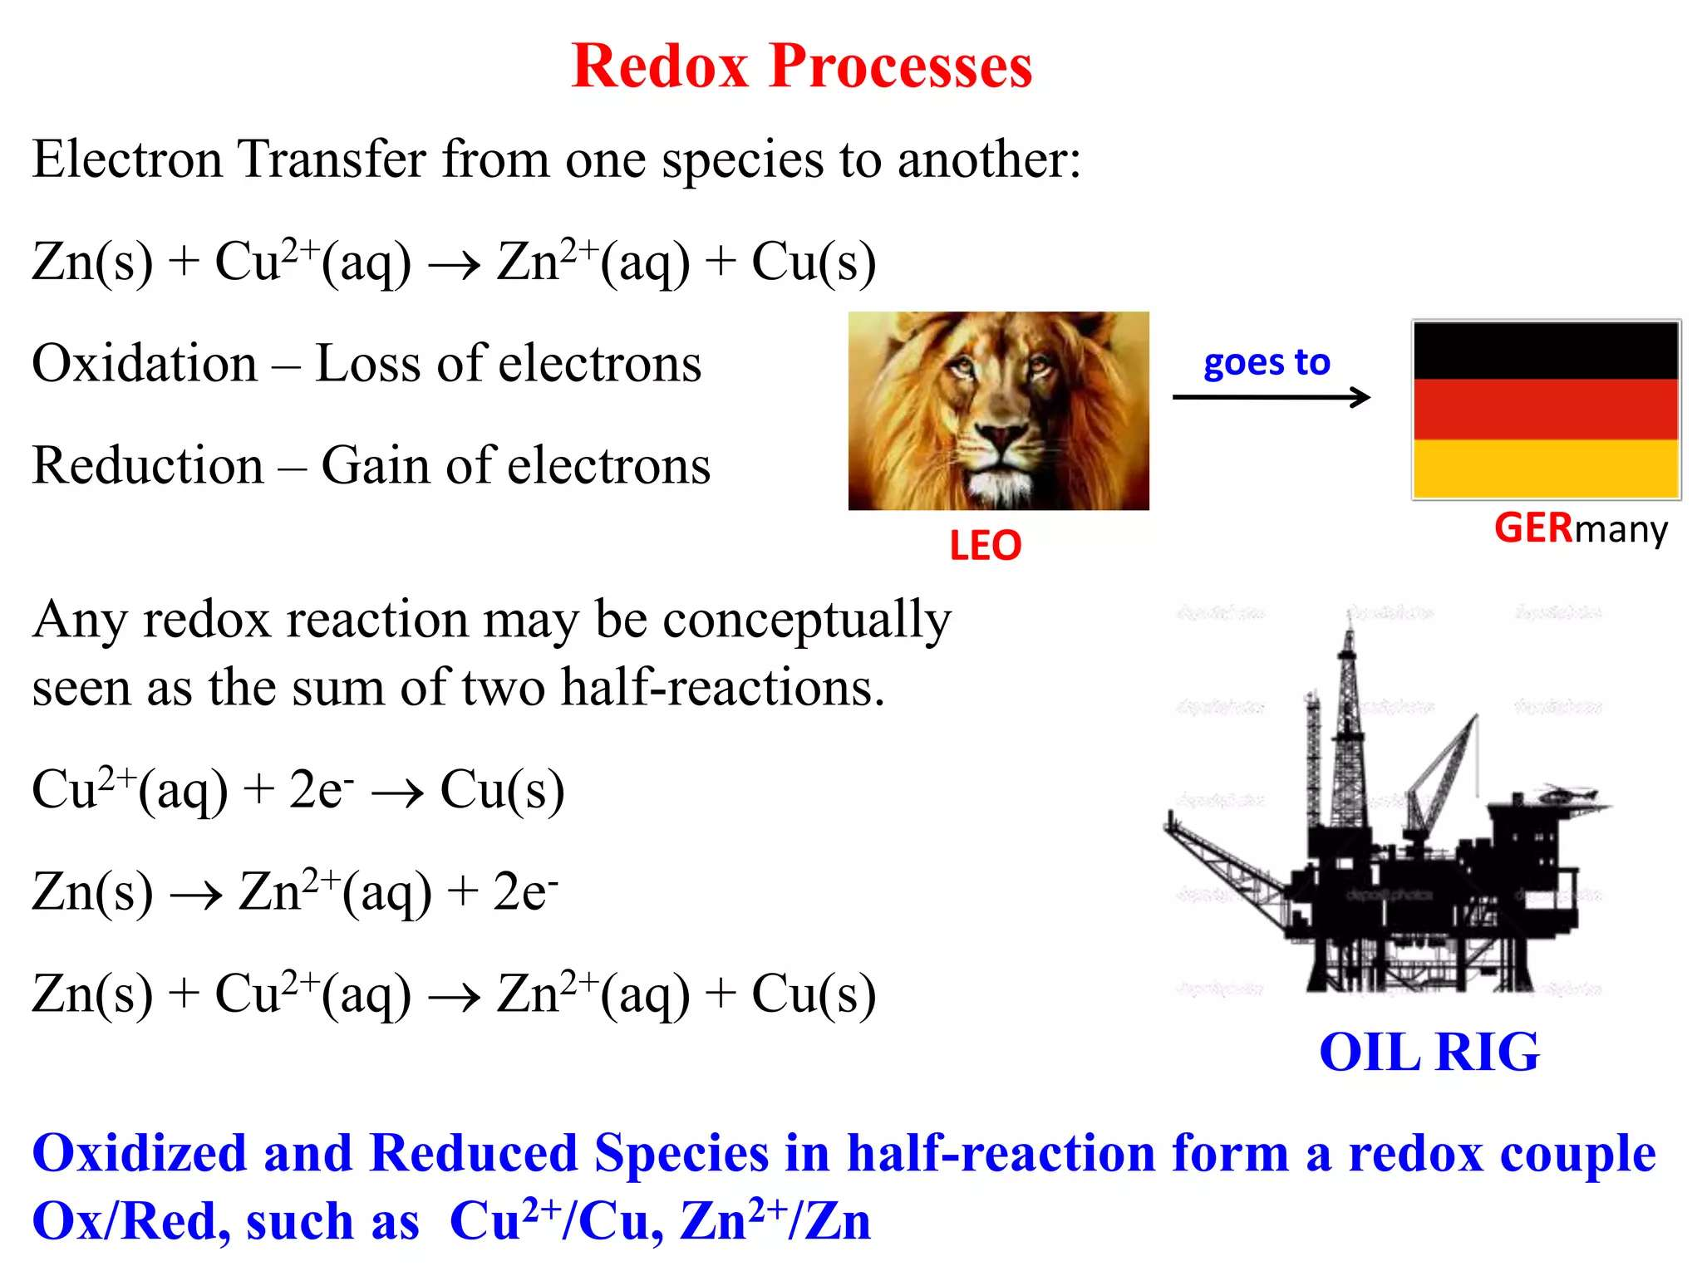

Slide 9
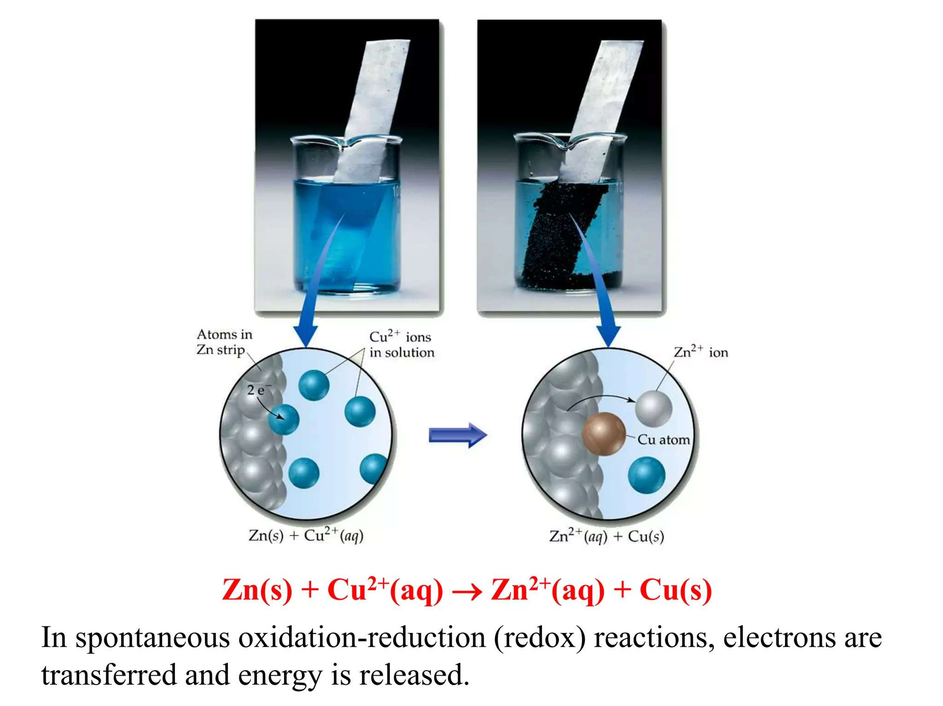

Slide 10
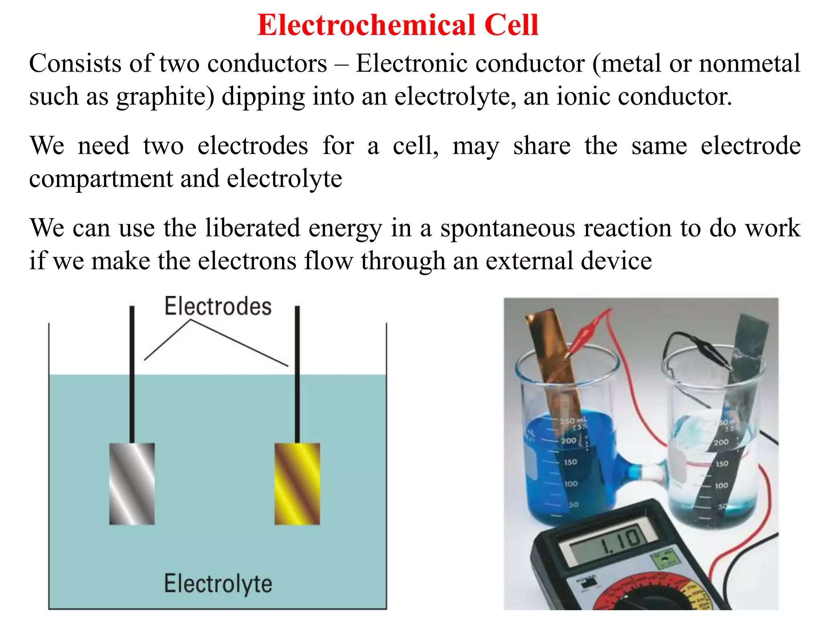

Slide 11
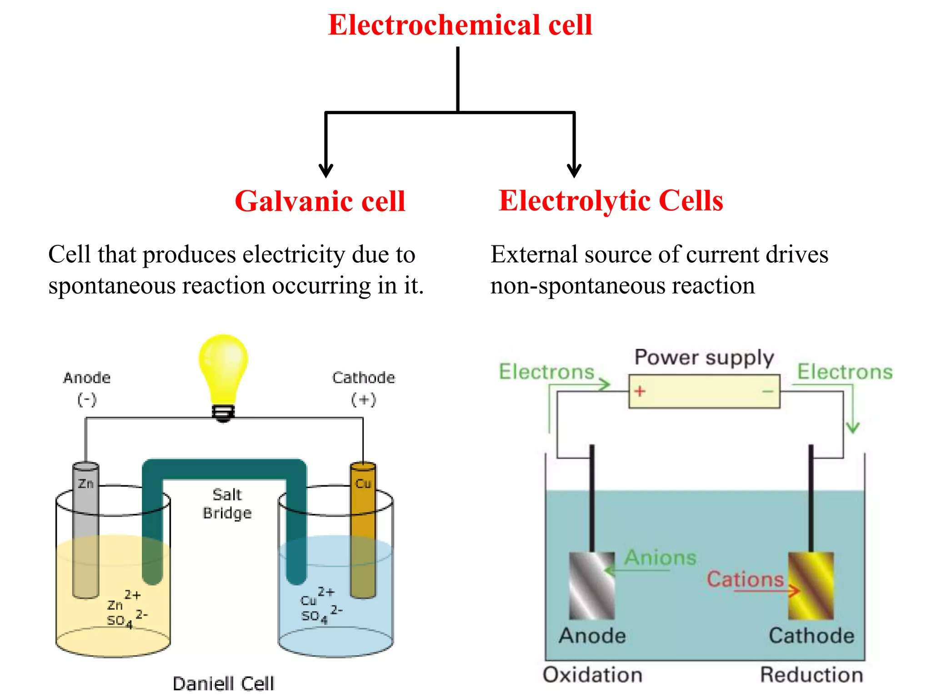

Slide 12
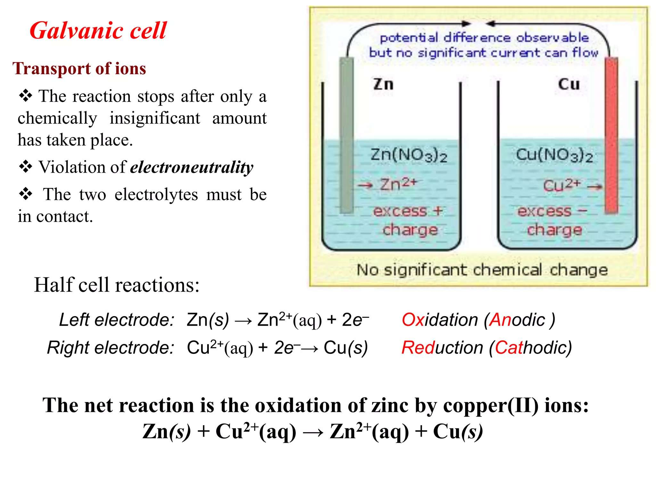

Slide 13
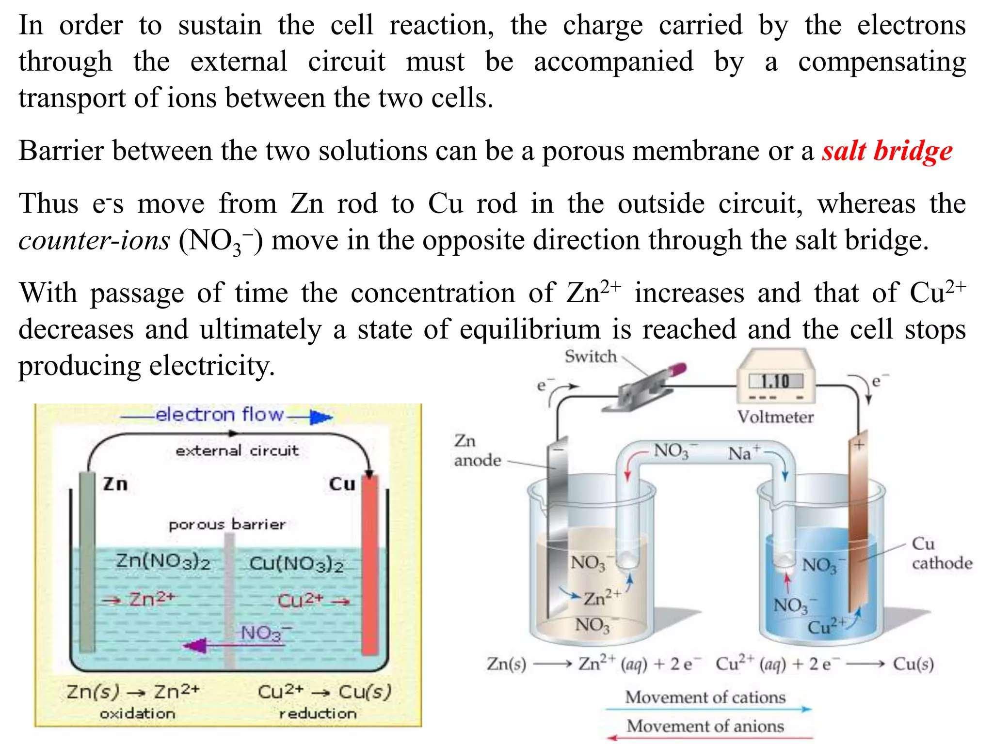

Slide 14
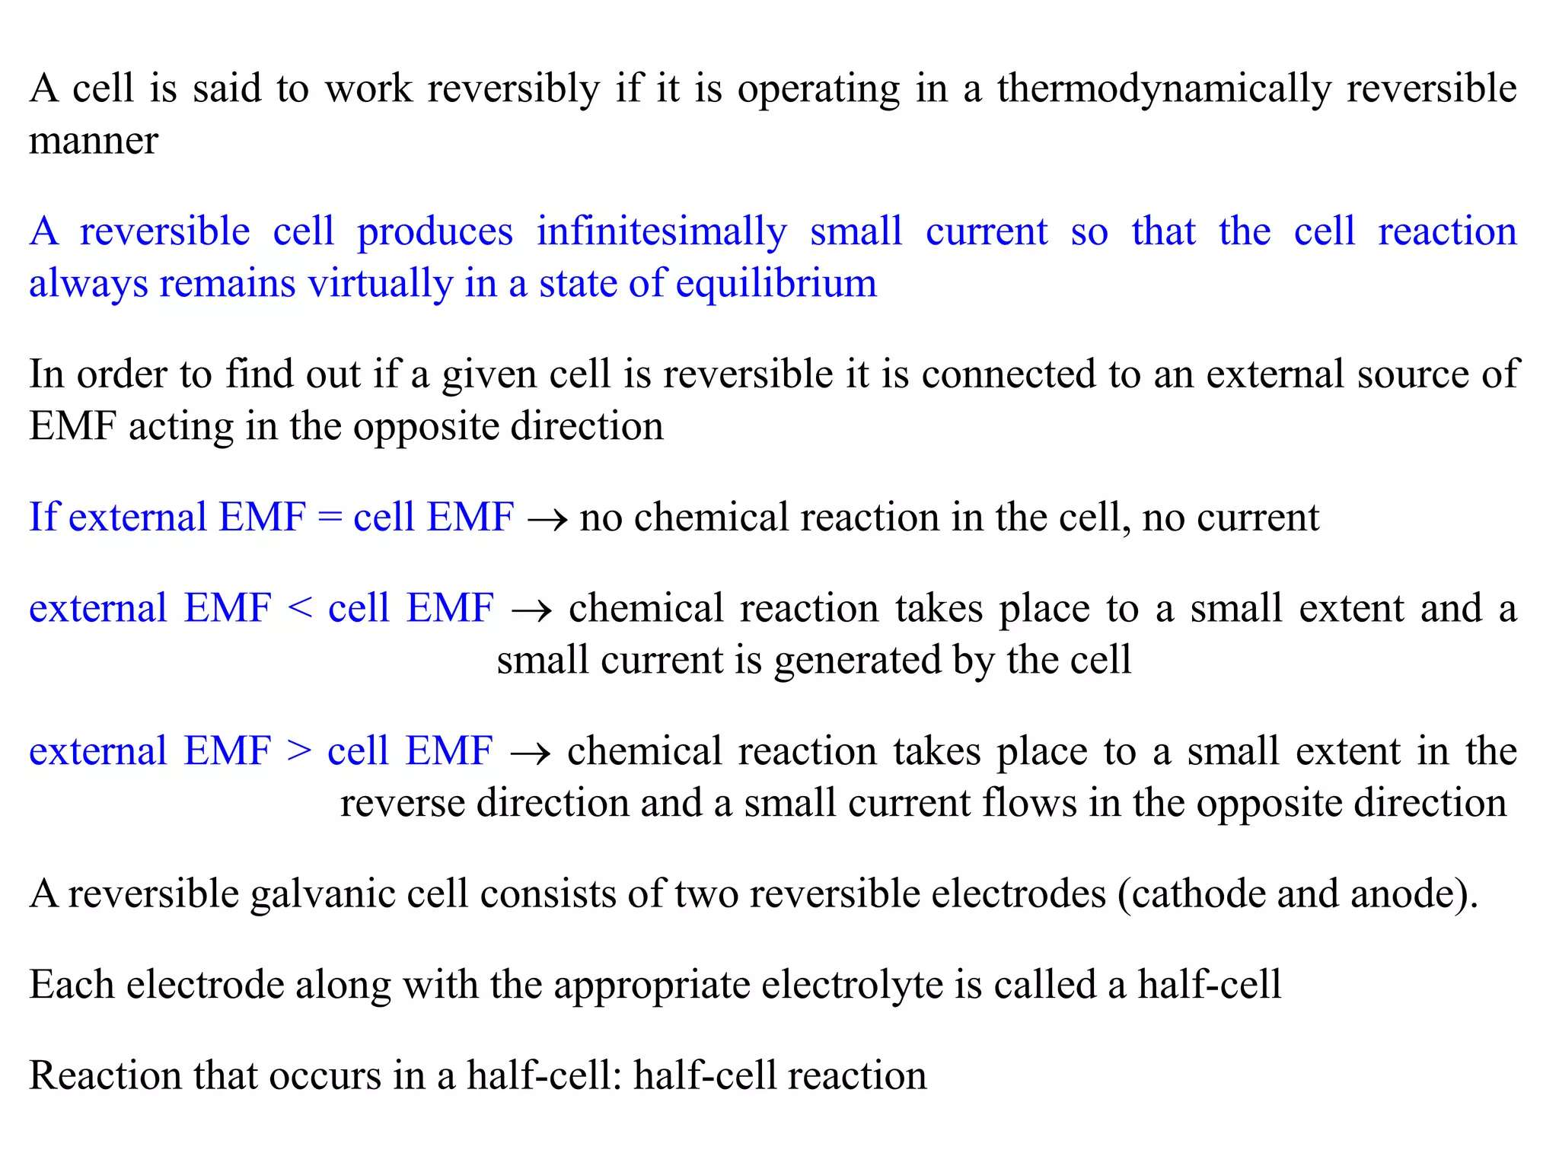

Slide 15
Q&A
🔹 Q1. MCQ
Which of the following is true for an electrochemical cell? a) Electrons flow from cathode to anode b) Oxidation occurs at cathode c) Electrons flow from anode to cathode through the external circuit d) Reduction occurs at anode
✅ Correct Answer: c)
🔹 Q2. MCQ
The standard EMF of a cell is calculated using: a) Faraday’s Law b) Nernst Equation c) Gibbs Free Energy d) Standard electrode potentials
✅ Correct Answer: d)
🔹 Q3. Short Answer
Write the cell representation for a Daniell cell. Indicate which electrode acts as the anode and which as the cathode.
✅ Answer: Zn(s) | Zn²⁺(aq) || Cu²⁺(aq) | Cu(s) Anode: Zn, Cathode: Cu

Slide 16
🔹 Q4. Short Answer
If the EMF of a cell is positive, what does it indicate about the spontaneity of the cell reaction?
✅ Answer: The reaction is spontaneous.
🔹 Q5. Calculation-Based MCQ
If the standard electrode potentials are: E°(Zn²⁺/Zn) = –0.76 V, E°(Cu²⁺/Cu) = +0.34 V What is the standard EMF of the cell: Zn | Zn²⁺ || Cu²⁺ | Cu? a) 1.10 V b) –1.10 V c) 0.42 V d) –0.42 V
✅ Correct Answer: a) 1.10 V

Slide 17

📚 Key Takeaways: Electrochemical Cells and EMF
Electrochemical cells convert chemical energy into electrical energy using redox reactions.
Oxidation always occurs at the anode and reduction at the cathode.
Electrons flow from anode to cathode in the external circuit.
Standard EMF (E°_{cell}) is calculated using the formula:
Positive EMF indicates a spontaneous reaction, while a negative value means non-spontaneous.
The cell notation represents oxidation on the left and reduction on the right.
Electrode potentials are referenced to the Standard Hydrogen Electrode (SHE).
EMF is affected by concentration, temperature, and pressure, as calculated using the Nernst equation.

Slide 18
📚 Textbook References
🔹 1. Principles of Physical Chemistry
Authors: Puri, Sharma, and Pathania Publisher: Vishal Publishing Co. Relevant Chapter: Electrochemistry Pages: Typically Chapter 7 or 8
✅ Clear explanations of galvanic cells, EMF, electrode potentials, and Nernst equation with solved numerical problems.
🔹 2. Physical Chemistry
Author: P. W. Atkins & Julio de Paula Publisher: Oxford University Press Relevant Chapter: Electrochemistry Pages: Electrochemical cells, thermodynamics of cells, Nernst equation
✅ Advanced treatment with thermodynamic background, good for concept building.
🔹 3. Essentials of Physical Chemistry
Author: Arun Bahl, B.S. Bahl Publisher: S. Chand Publishing Relevant Chapter: Electrochemistry
✅ Student-friendly language, step-by-step derivations and basic to moderate numericals.
🔹 4. University Chemistry
Author: Bruce Mahan Publisher: Pearson Education Relevant Sections: Electrochemical principles and potentials
✅ Good for theoretical foundation and standard cell construction.
📌 Online Resources
NPTEL Video Lectures: Physical Chemistry – Electrochemistry Module (by IIT Kharagpur or Bombay)
LibreTexts Chemistry: https://chem.libretexts.org – Free and accessible with good examples
🔹 5. Textbook of Physical Chemistry
Author: K. L. Kapoor Publisher: Macmillan Relevant Volume: Volume 3 – Electrochemistry
✅ In-depth derivations, rigorous treatment of EMF and electrode kinetics.

